Slide 1
AUTONOMOUS SWARM ROBOTS
Built and perform by:
Meet Patel (400486035)
Jay Patel (400175525)
Vichal Daliya (400485779)
Tushar Bhuva (400486950)
Nikulkumar Dabhi (400490758)
Het Shukla (400490742)

Slide 2
Problem Statement
“An automated system consisting of multiple robots designed to efficiently and safely complete large, slow, and hazardous tasks”

Slide 3
Definition
“Build an autonomous multi robot system popularly known as swarm robots is being built for performing the slow and risky tasks more efficiently than the humans in which the robots communicate and coordinate among themselves through their artificial swarm intelligence to complete the given end task.”

Slide 4
Brief About Project
“This unmanned ground multi robot system will implement the solution by first building two mobile robots using Arduino Unos and IR sensors. From the two robots, one robot will act as master robot and the other robot will act as a slave robot”

Slide 5
Master Slave Communication
The autonomous multi-robot system operates with a master robot that autonomously determines the path to complete a given task. The master robot then communicates with a slave robot, directing it to follow and cooperatively complete the task. This communication method between the two robots is referred to as master-slave communication.

Slide 6
Task Performed
Requirement Analysis
Selection of Algorithm
Paper based simulating a blueprint of a project
Sketch the general structure of a solution
Hardware selection integration a Synchronization
Selection of Software Resources
Testing of algorithms
Designing and Building GUI
Coding
Implementation
Testing
Final Deliverables

Slide 7
Components Used
Arduino - 2 Nos.
RF Transmitter and Encoder Module - 1 No.
IR Sensors 2 Nos.
Arduino UART cable - 1 No.
L239D Motor Driver Circuit - 2 Nos.
DC motors - 4 Nos.
Wheels for Motors - 4 Nos.
Castor Wheels - 2 Nos.
Chassis - 2 Nos.
U Clamps - 4 Nos.
Wire stripper
Screwdriver
Connecting wires
Battery (9V)

Slide 8
Technologies that used
Arduino IDE
Python Programming Language
C Programming Language
C++ Programming Language
Machine Learning & Computer Vision (For Future Scope)
Robotics

Slide 9
Master v/s Slave Robots
Master Robot | Slave Robot
This controls all the other robots in swarm. | This will be controlled by the master robots.
There will be only one master. | There are so many slaves present in a swarm application.
They are intended to guide the slaves. | They are intended to do certain task given by the master.
They take decision from their own under critical conditions. | They can’t take own decisions by their own.

Slide 10
Progress
Set up of the freenove arduino Kit
Coding the master robot and optimizing its output
Single Arduino and IR Sensors based Autonomous Path (Line) Follower Bot
Coding the slave robot and optimizing its output
Transmitting and Receiving Signals using RF Transmitter, RF Receiver and 2 Arduino Uno
Autonomous Swarm Robots Prototype

Slide 11
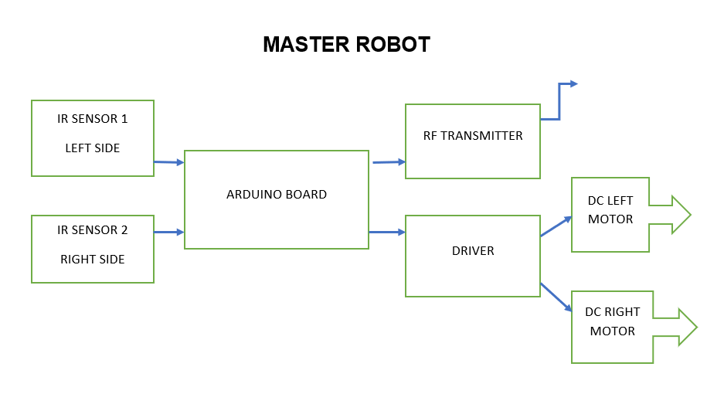
Flow Chart

Slide 12
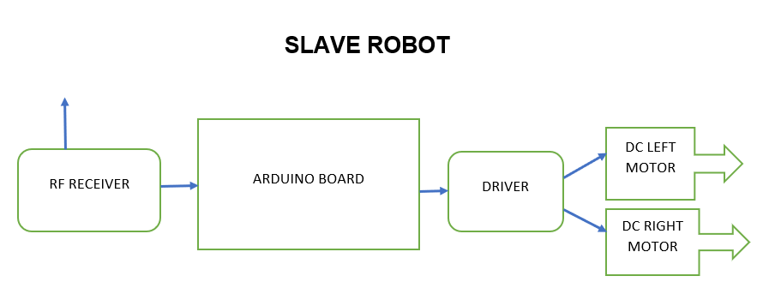
Flow Chart

Slide 13
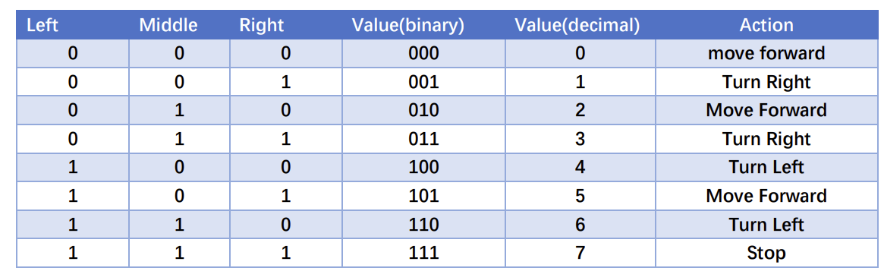
Master Robot Sensor logic

Slide 14
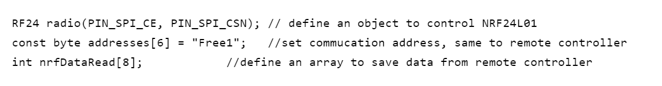
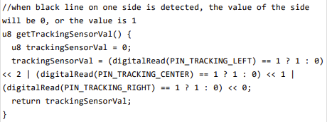
Code for Master Robot (Transferring Signal)

Slide 15

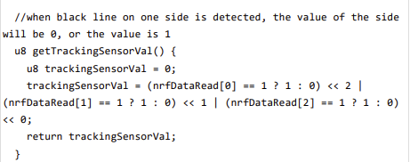
Code for Slave Robot (Receiving Signal)

Slide 16
Applications
In healthcare - for drug delivery and surgery
In industry - for mass manufacturing with high accuracy and speed
In space Research - for space exploration
In logistics - to transport and organize goods
In military - for monitoring and Surveillance of enemy
In Agriculture - Planting, watering and Harvesting Crops
Reference [1]

Slide 17

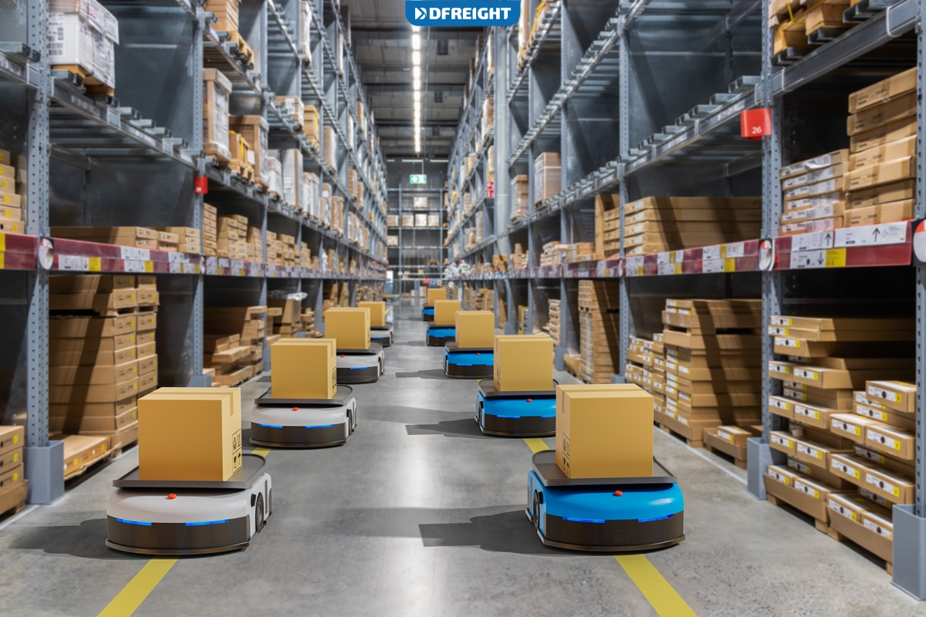
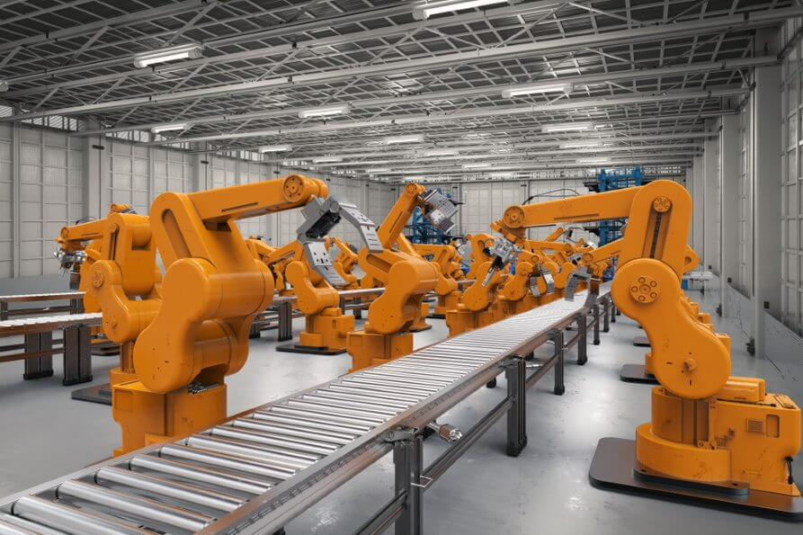

Slide 18
Advantages
Robustness - even if few robots fail other will work efficiently
Scalability - number of robots increased or decrease as per task requirement
Efficiency - they can do task parallely and complete it rapidly
Collective intelligence - each robot can communicate with each other in swarm and can share information which enhance the efficiency
Reference [2]

Slide 19
Disadvantages
Communication between robots - if there is no clear communication instead of cooperating they start competing
Programming the robots- slave robots have to quickly adapt to new tasks and scenarios which need complex programming
Interference- robots might collide with each other and may decrease the efficiency
Reference[3]

Slide 20
Conclusion
Swarm of Robots are able to avoid obstacles and find their paths autonomously by themselves.
Swarm of Robots are able to communicate and coordinate with each other and are able to move faster and complete the tasks efficiently than humans.
Swarm robotics is more flexible than other robotic system.
Since Swarm robotics can adapt to any environment, it can be used with very few or none limitations.

Slide 21
Future Work
Gaseous Smoke Detection using Arduino UNO and MQ 135 Gas Sensor
Incorporating Artificial Intelligence for decision making after taking response from each slave robots
Implementation of Machine Learning for adaptive action based on surrounding environement
Application of Computer Vision for performing quality and inspection in manufacturing Industry.

Slide 22
References
http://data.conferenceworld.in/BHIMA/P419-423.pdf
https://www-ncbi-nlm-nih-gov.libaccess.lib.mcmaster.ca/pmc/articles/PMC7805972/#:~:text=They%20traditionally%20cooperate%20without%20any,adaptability%2C%20robustness%2C%20and%20scalability.
https://ts2.space/en/swarm-robotics-vs-traditional-robotics-a-comparison/

Slide 23
Thanks !!!

